Slide 1
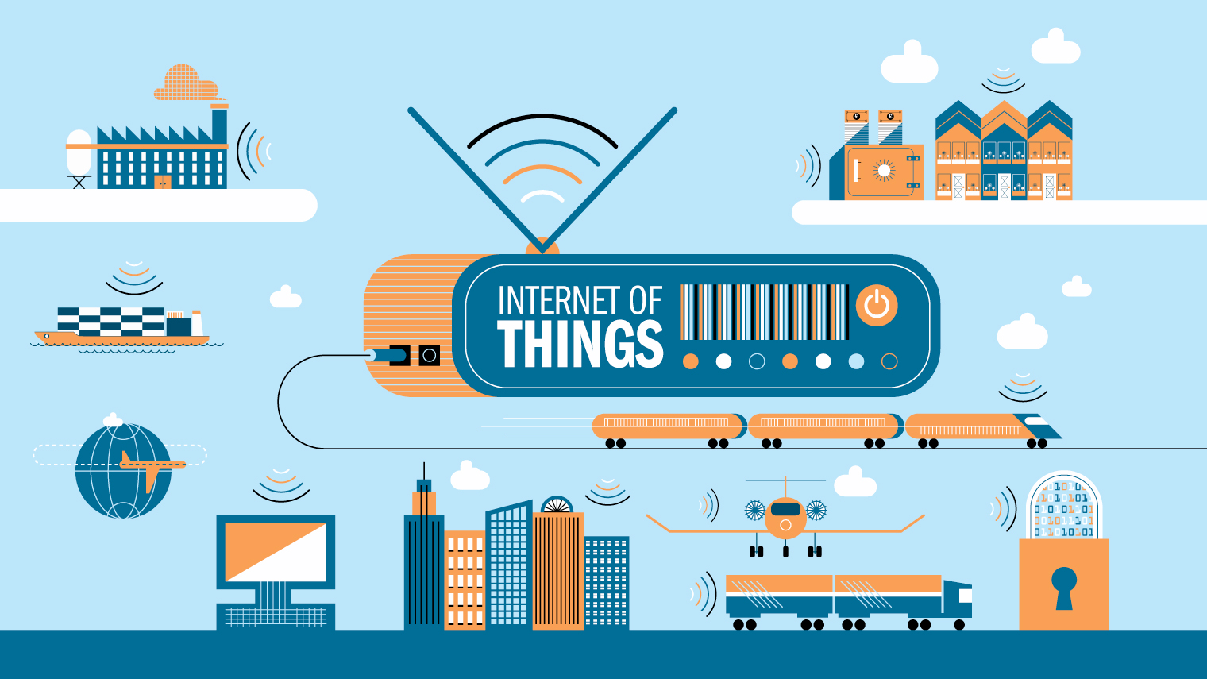


Secure integration of Internet of Things
January 08th, 2016
Huynh Dan VO
Notes:
Good morning, My name is Dan
Today I’d like to talk about my work during the 6-month internship in a topic named …..
I worked with Mr. Laurent in the Research Team of SAP company

Slide 2
AGENDA
INTRODUCTION
CRYPTOGRAPHY
INTERNET OF THINGS
SAP HANA CLOUD PLATFORM
DEMO
CONCLUSION
Notes:
Introduction – General view of this scenario
Cryptographic scheme
All components used in my work – Internet of Things, and SAP HCP
I’ll show a video running an integrated application to display the data to user

Slide 3



Secure Predictive Maintenance @ Antibes
Monitor water distribution network, predict failures, and proactively optimize their finance and controlling
Motivation
Connect operational levels to finance and controlling
Technical characteristics
2000 sensors instrumenting the network
Low bandwidth and powered programmable logic controllers (PLCs)
No physical access to devices
Low throughput
No personal data
Security requirements expressed by Antibes
End to end data confidentiality
Data integrity
Notes:
We are working on a project which is an association between City of Antibes, SIGFOX network provider, and SAP.
We would like to monitor water distribution network, predict failures, and proactively optimize their finance and controlling.

Slide 4
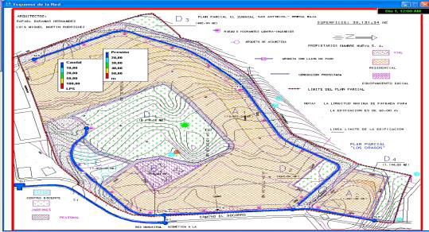

Objectives Water network visualization real time
Visualization real time of water network integrity
Static information related to geolocation, physical characteristic of pipelines.
Acquisition of data from smart metering devices in the city
Debit, pressure, turbulence, intrusion detection, tank level, …
Predictive model for water pipeline failure
Based on static and real time acquired from sensor data
From static data on pipeline
Physical characteristics
Age
Previous incident
Real time information
Water pressure into pipeline,
Water consumption from smart meter
Notes:
So what would we do with the data,
We visualize them on the app. Data is water flow, pressure, turbulence
How to predict, base on static real time
Dựa vào static data – tuổi, thuộc tính, tai nạn sự cố trước đó
Dựa vào thông tin thực – real time information
Water pressure
Water consumption

Slide 5
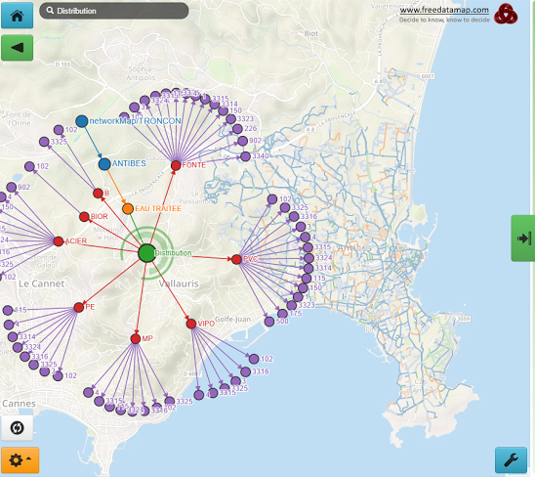
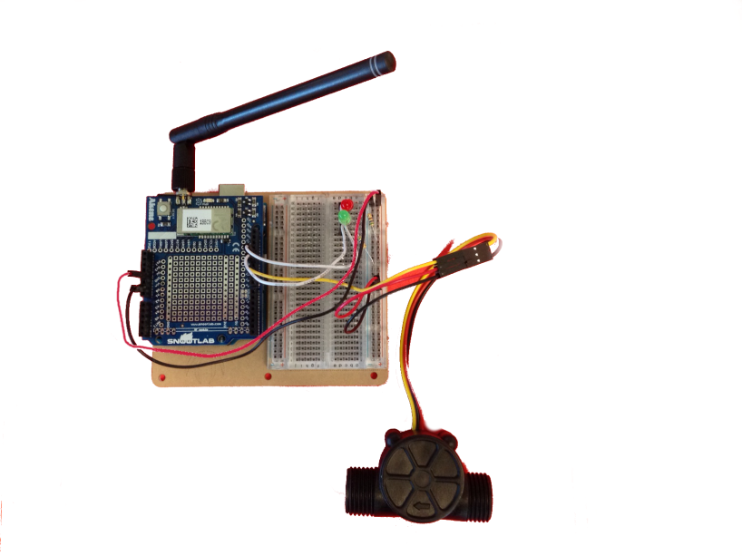
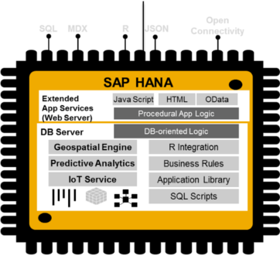
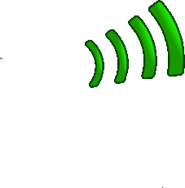




Overview
Predictive Maintenance @Antibes
DashBoard
Notes:
Here is an overview of how everything works together.
Set up the connection
- End to end encryption confidentiality
explain a bit better the process of end to end encryption

Slide 6
Overview
Predictive Maintenance @Antibes
DashBoard
Notes:
End to end encryption confidentiality

Slide 7
Overview
Predictive Maintenance @Antibes
DashBoard
Notes:
End to end encryption confidentiality

Slide 8
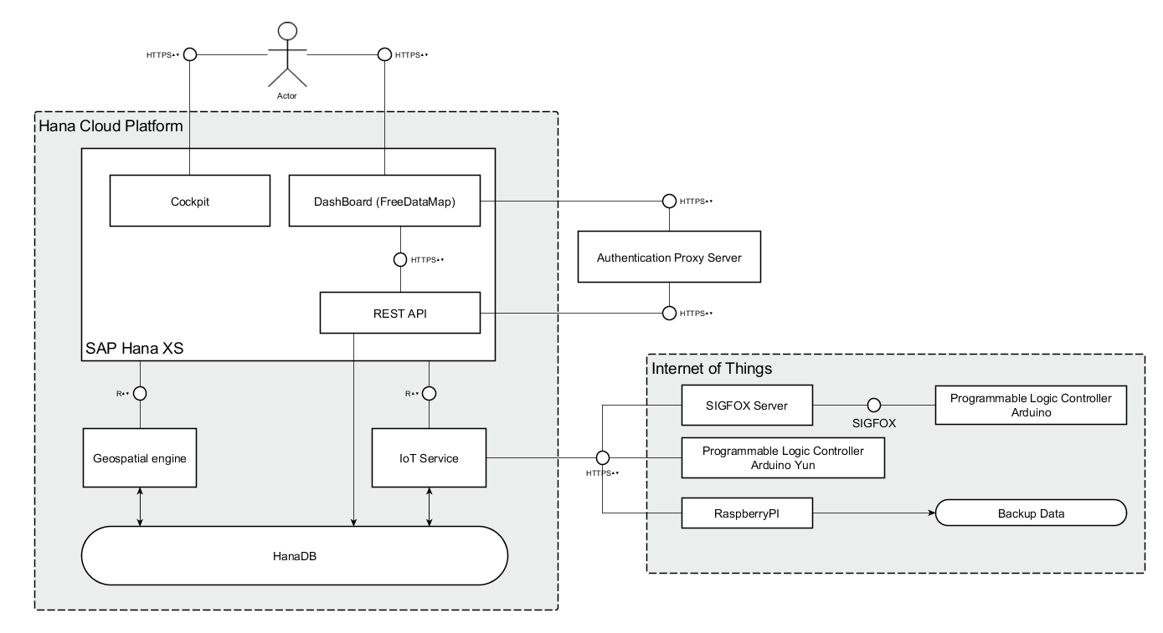
Architecture View
Notes:
Explain in the components, roles – (Arduino single-board microcontroller – Ras Pi : single-board computer)
+ Collect data
+ Send data
+ Expose data
Message flows

Slide 9
Efficient Access Control (EAC) to Sensor Data
Reference : http://www.eurecom.fr/en/publication/2473/download/ce-publi-2473_3.pdf
Why ?
Embedded security for low powered device
Low battery consumption
Low bandwidth (12-byte message)
Notes:
Then we propose to use EAC ...
Explain AL value, Derivation of keys

Slide 10
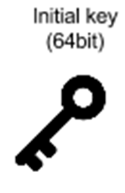



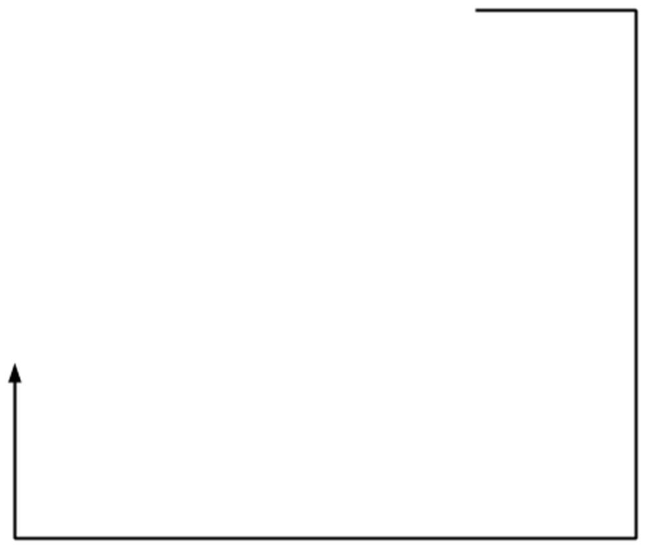
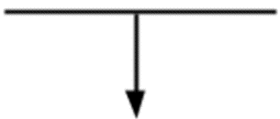
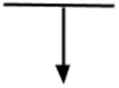

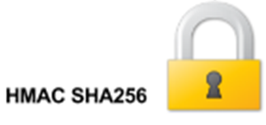



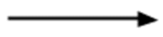
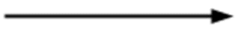

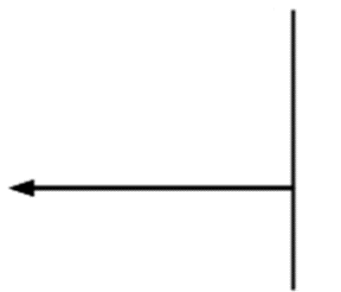

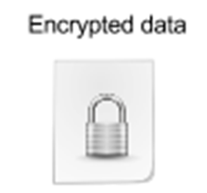

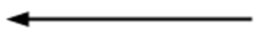


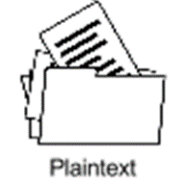
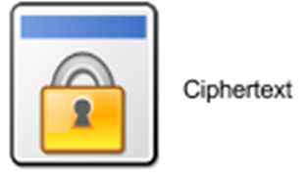
Modification of the EAC
ENCRYPTION
Key generation system
HMAC SHA256
Process
{K_1} = HMAC_SHA256({K_0},AL}
{K_2} = HMAC_SHA256(K_1,ID|SEQ)
E = OneTimePad(P,{K_2})
E* = (E+SEQ)
C = Base64Encoding(E*)
Notes:
I did the modification - Why ?
What is my contribution - explain everything
Why base64 ?

Slide 11
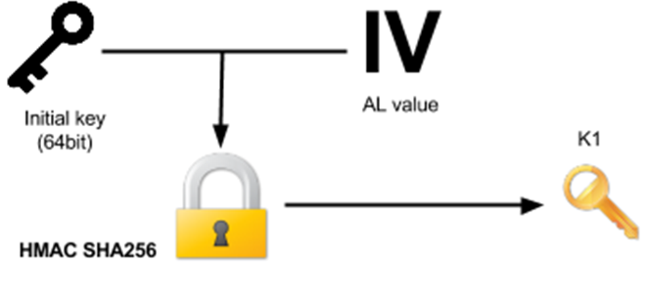
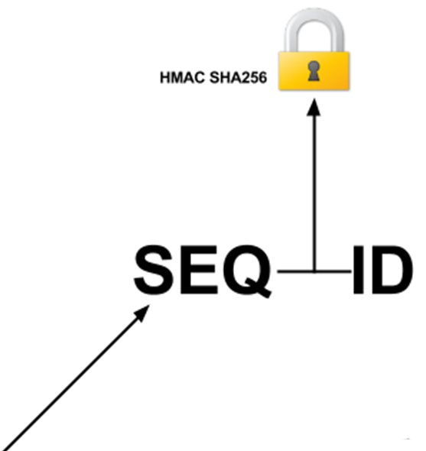
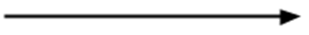
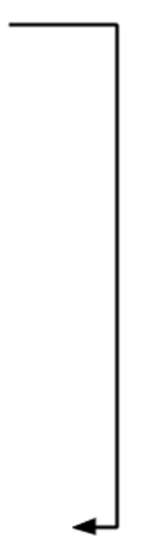
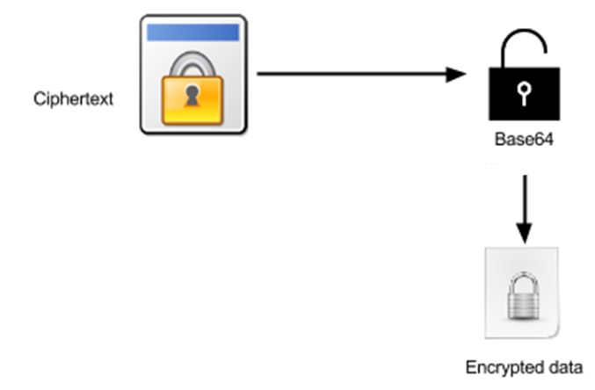
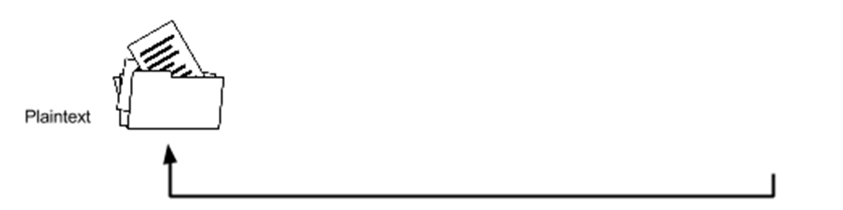
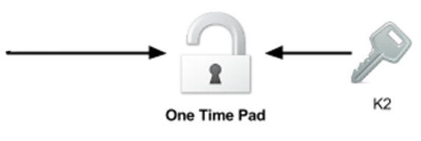
Modification of the EAC
DECRYPTION
Key generation system
HMAC SHA256
Process
E* = Base64Decoding(C)
{K_1} = HMAC_SHA256({K_0},AL)
(SEQ+E) = E*
{K_2} = HMAC_SHA256(K1,ID|SEQ)
P = OneTimePad(E,{K_2})

Slide 12

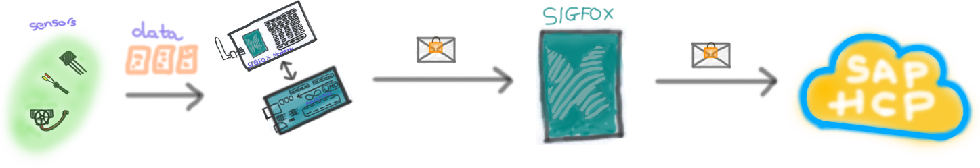

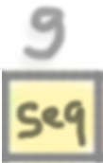

Payload
Encrypted data
+
Sequence No
Notes:
Talk about Evaluation + Model attacks

Slide 13
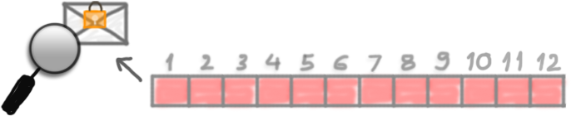
Payload
Base64Encoding
{
Encrypted data
+
Sequence No
}
Notes:
Talk about Evaluation + Model attacks

Slide 14

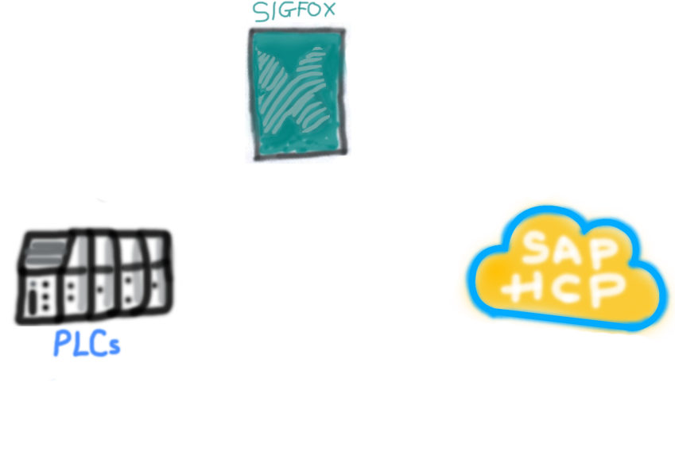
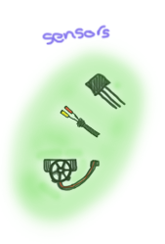
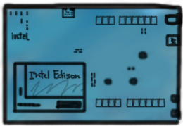
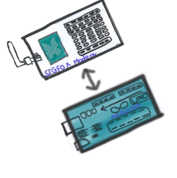
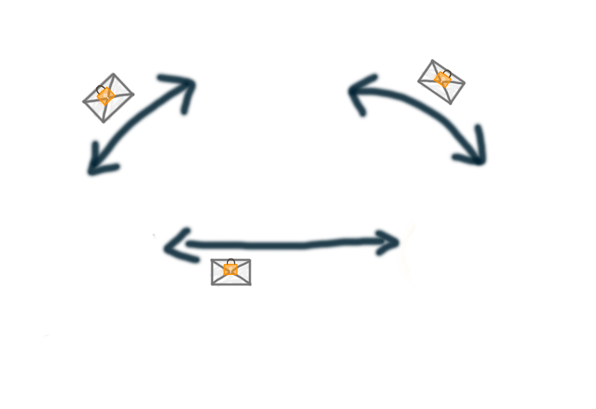
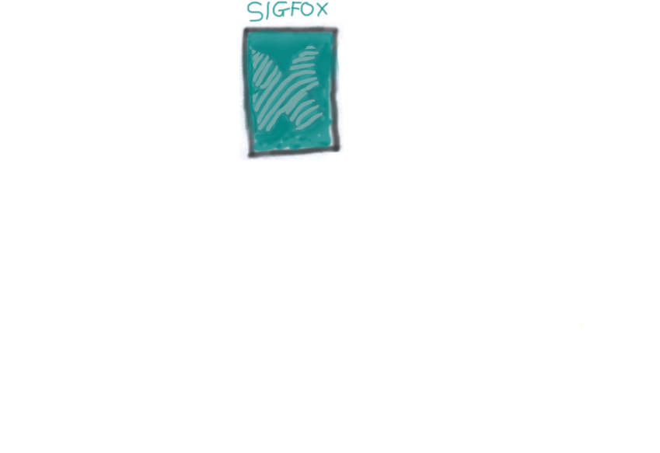
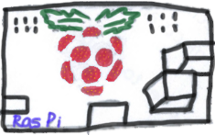
Attack models
Three targets:
Communications between devices and systems
Between PLCs and SIGFOX.
Between PLCs and SAP HANA Cloud Platform (SAP HCP).
Between SIGFOX and SAP HCP.
Devices
Sensors
Programmable Logic Controllers (PLCs)
SIGFOX modems
Back-end systems
SIGFOX
SAP HCP
Notes:
What are goals - What are assumptions
the attacker wants to decrypt messages, interfere predictive attack models
gives assumption - what he is able to do
How he can do ? - attack models

Slide 15



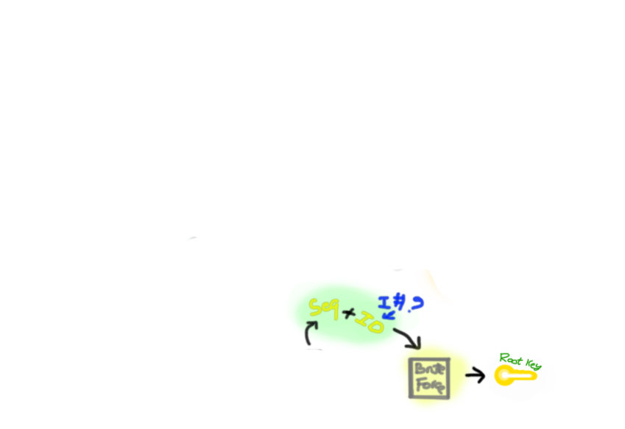
Attack models Communications between devices and systems
Replay attack
Ciphertext-only attack
Payload modification
Brute-force attack
Notes:
Assume he has only access to capture messages, know about technologies about sigfox and sap hcp
The attacker listens to communications between PLCs and SIGFOX, PLCs and SAP
HCP, SIGFOX and SAP HCP. He captures messages in order to perform further
attacks on the systems such as replay attack, or DDOS attack.

Slide 16
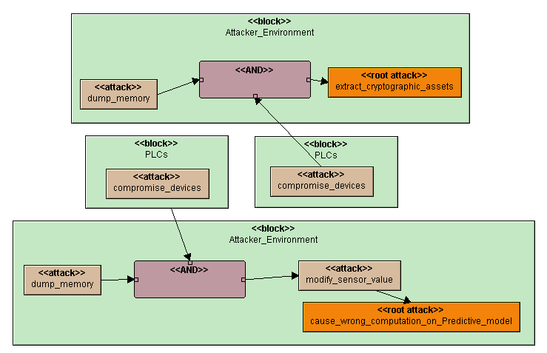
Attack models Devices
Hacking
Device Physical Interfaces
Device Memory
Local Data Storage
Notes:
The attacker listens to communications between PLCs and SIGFOX, PLCs and SAP
HCP, SIGFOX and SAP HCP. He captures messages in order to perform further
attacks on the systems such as replay attack, or DDOS attack.

Slide 17
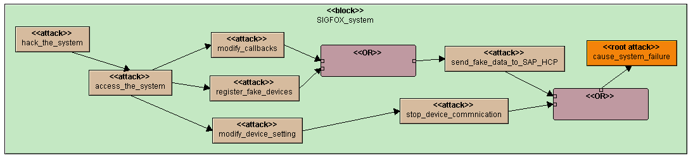
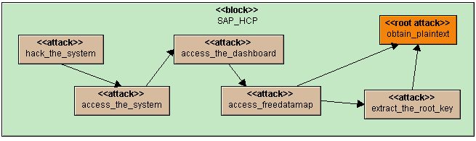
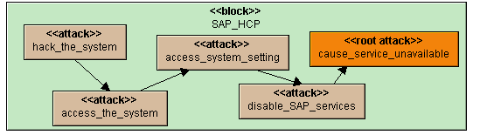
Attack models Back-end Systems
Attacks on SIGFOX backend
Attacks on SAP HANA Cloud Platform
Notes:
SIGFOX: Goal -> access to the system -> developer/admin dashboard -> get the token
(SIGFOX : gain access to developer / admin account to modify and get access to information)
SAP HCP: -> Dashboard-> Plaintext - root key,
(SAP HCP : explain that is gain access to the system as admin or developer on the system to get access to the source code ...)

Slide 18
Implementation
In C/C++ for Arduino as a library
In Python for Raspberry Pi
In JavaScript for integrated applications
Notes:
I implemented the cryptographic scheme

Slide 19
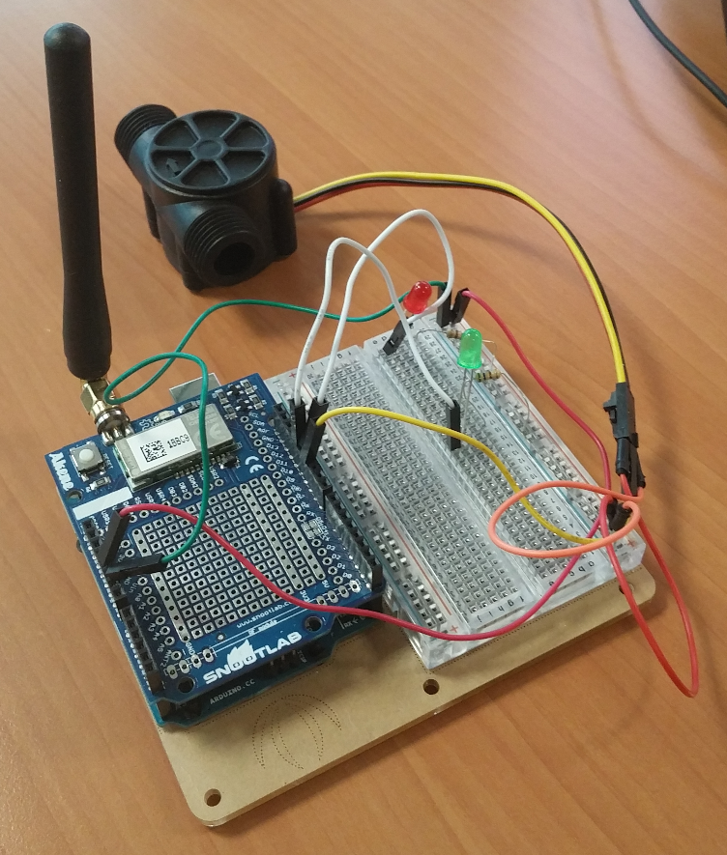
Internet of Things Devices – Arduino
Gather water consumptions, or temperature data from sensors.
Encrypt data following the cryptographic scheme.
Send data.
Notes:
A PLC device – Piece of hardware
Tell what to do with Arduino

Slide 20
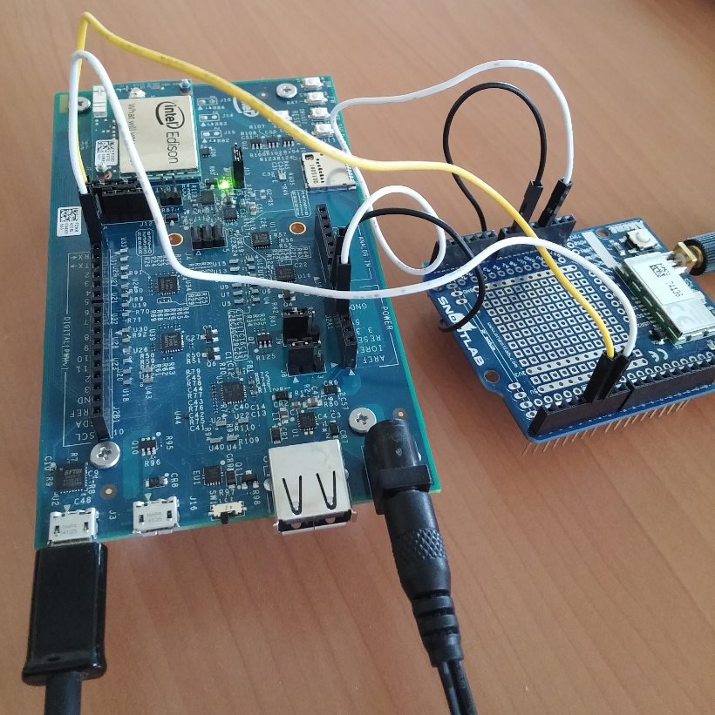
Internet of Things Devices – Intel Edison
Set-up Intel Edison device with Akene Shield
Push data to SIGFOX back-end
Encrypt messages following the scheme
Send to SIGFOX back-end.
Notes:
A promising device, which is as known as a mix between a PLC, and a single-board
computer,

Slide 21
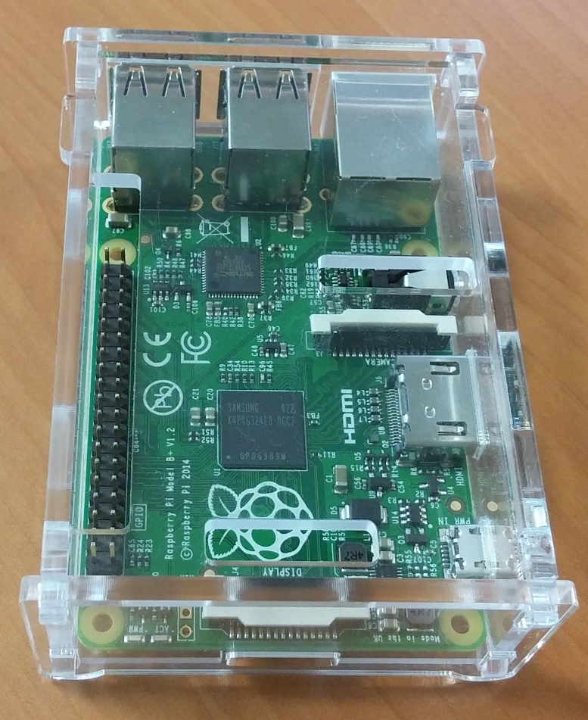
Internet of Things Devices – Raspberry Pi
Push data to HCP IoT Service
Directly collect encrypted data from Arduino, and push it to SAP HCP IoT.
Take offline data, encrypt it, and send it to SAP HCP IoT.
Extract, and send geolocation data to SAP HCP IoT follow the cryptographic scheme.
Notes:
Raspberry Pi is a single-board computer with a micro processor, and can run an OS.

Slide 22
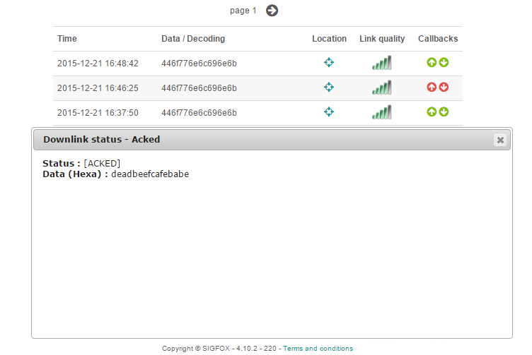
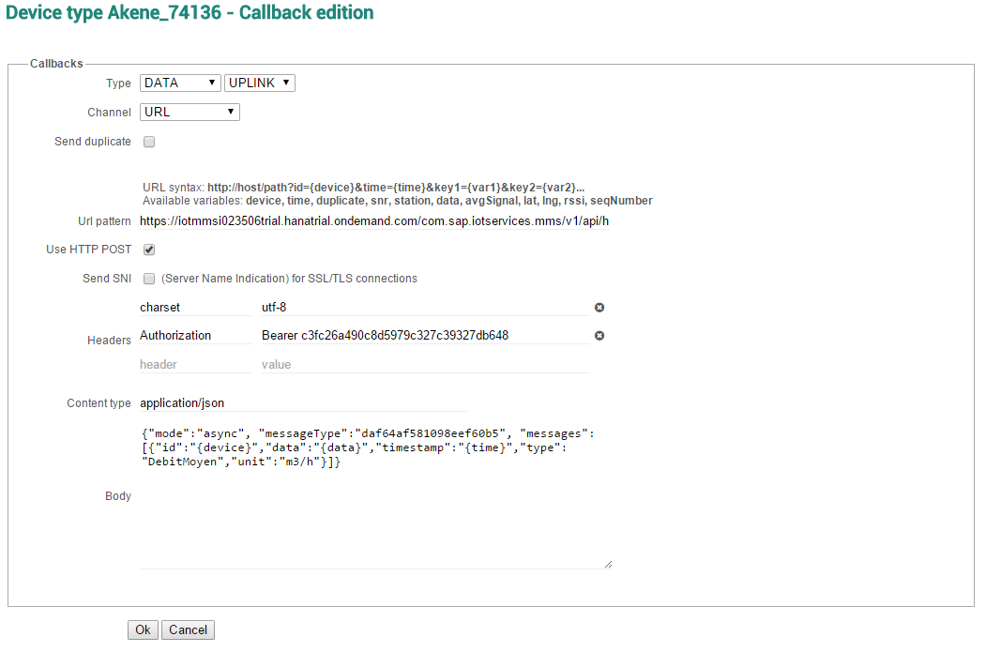

Internet of Things SIGFOX - IoT Network Provider
Callback configuration
Downlink callbacks
Send collected data from devices to SAP HCP.
Used to implement the re-keying in future work.
Register devices
Sent a request from Arduino
SIGFOX back-end send request to server , and wait for a response
Set up callbacks
Receive messages, and send them to SAP HCP.
Server sends response to SIFFOX back-end
SIGFOX sends back response to Arduino
Notes:
SIGFOX callbacks is set up to transfer collected data from devices to SAP HCP.
This feature [28] will be used to implement the re-keying in future work.

Slide 23
Integration with Hana Cloud Platform HANA Cloud Platform IoT
Configure to receive, store messages from SIGFOX, and devices
Enable, and configure SAP IoT Service
Enable, and configure HANA XSJS, and HANA DB services
Build REST API to expose the collected data
Build REST API with OData
Build REST API with HANA XSJS
Grant user permissions to use REST API
A Dashboard with the integration of FreeDataMap with SAP UI5
Build a dashboard by SAP HANA Web IDE service as a HTML application.
Do a workaround to retrieve information from the REST API built by HANA XS
Integrate FreeDataMap on the Dashboard by using SAP UI5
Notes:
Tell what to do with Arduino
Roles
Works

Slide 24

DEMO

Slide 25
Conclusion
Implementation of the Proof of Concept.
Implementation of the cryptographic scheme
C/C++, Python, and JavaScript languages.
Attack models
Documentation
Notes:
To sum up, we have presented, and implemented the cryptographic scheme to pro-
tect the data. The scheme which overcomes the limitation of message transmission is
applied in C/C++, Python, and Javascript languages. In addition, we also success-
fully implemented the Proof of Concept. We are able to collect the data, encrypt,
store, and display it on SAP HCP Dashboard. Furthermore, we also created a
Github to replicate the Proof of Concept.

Slide 26
Future work
Key management system
Re-keying feature
Hardware security on IoT devices
Data integrity
Notes:
As future work, we intend to focus on another requirement which is data integration.
We have a very first step for key management system by using the cryptoshield, and
re-keying feature via SIGFOX downlink callbacks. A set of keys could be used and
changed frequently on devices to improve the security. Moreover, it is also very
interesting if we integrate hardware security on IoT devices to use secure storage,
and secure hash algorithms.

Slide 27
Planning

Slide 28

Q & A

Slide 29
Thank you
Huynh Dan VO
Huynh-Dan.Vo@eurecom.fr

